Slide 1
Predicting Diabetes in Human Beings
Eniola Olawoagbo
Oluwagbemi Lesi

Slide 2
Goal
Our goal is to predict Diabetes in Human beings using females of at least 21 years old of Pima Indian heritage.
According to World Health Organization (WHO), about 422 million people are living with diabetes around the world. By 2035, this number will be increased to 592 million.

Slide 3
How Do We Become Diabetic
Food powers our bodies. When we eat food our bodies turn it into glucose, this occurs in our liver and gut.
Then, our bodies produces insulin through the pancreas which in turn converts glucose in our cell walls into energy for our cells.
Diabetes occurs when the body (Pancreas) does not produce any or enough insulin to break down glucose into energy for our body cells.

Slide 4
Context
This dataset is originally from the National Institute of Diabetes and Digestive and Kidney Diseases.
The objective of the dataset is to diagnostically predict whether or not a patient has diabetes, based on certain diagnostic measurements included in the dataset.
Several constraints were placed on the selection of these instances from a larger database.
In particular, all patients here are females of at least 21 years old of Pima Indian heritage.
The Pima are a group of Native Americans living in an area consisting of what is now central and southern Arizona, as well as northwestern Mexico in the states of Sonora and Chihuahua.

Slide 5
Content
The datasets consists of several medical predictor variables (X) and one target variable, Outcome (Y).

Slide 6
PREDICTOR VARIABLE (X)
Pregnancies - (Number of times pregnant)
Glucose in the Blood- (Plasma glucose concentration a 2 hours in an oral glucose tolerance test)
Blood Pressure - Diastolic blood pressure (mm Hg)
Skin Thickness - Triceps skin fold thickness (mm)

Slide 7
Insulin Level - 2-Hour serum insulin (mu U/ml)
BMI (Body Mass Index) (weight in kg/(height in m)^2)
Diabetes Pedigree Function - (Information about diabetes history in relatives and genetic relationship of those relatives with patients).
Higher Pedigree Function means patient is more likely to have diabetes.
Age (Years)

Slide 8
Data Exploration and Pre-processing

Slide 9
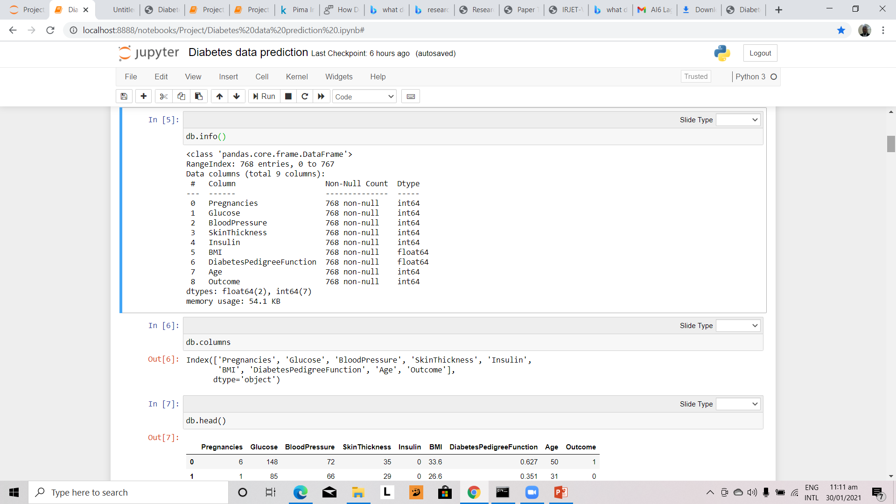

Slide 10
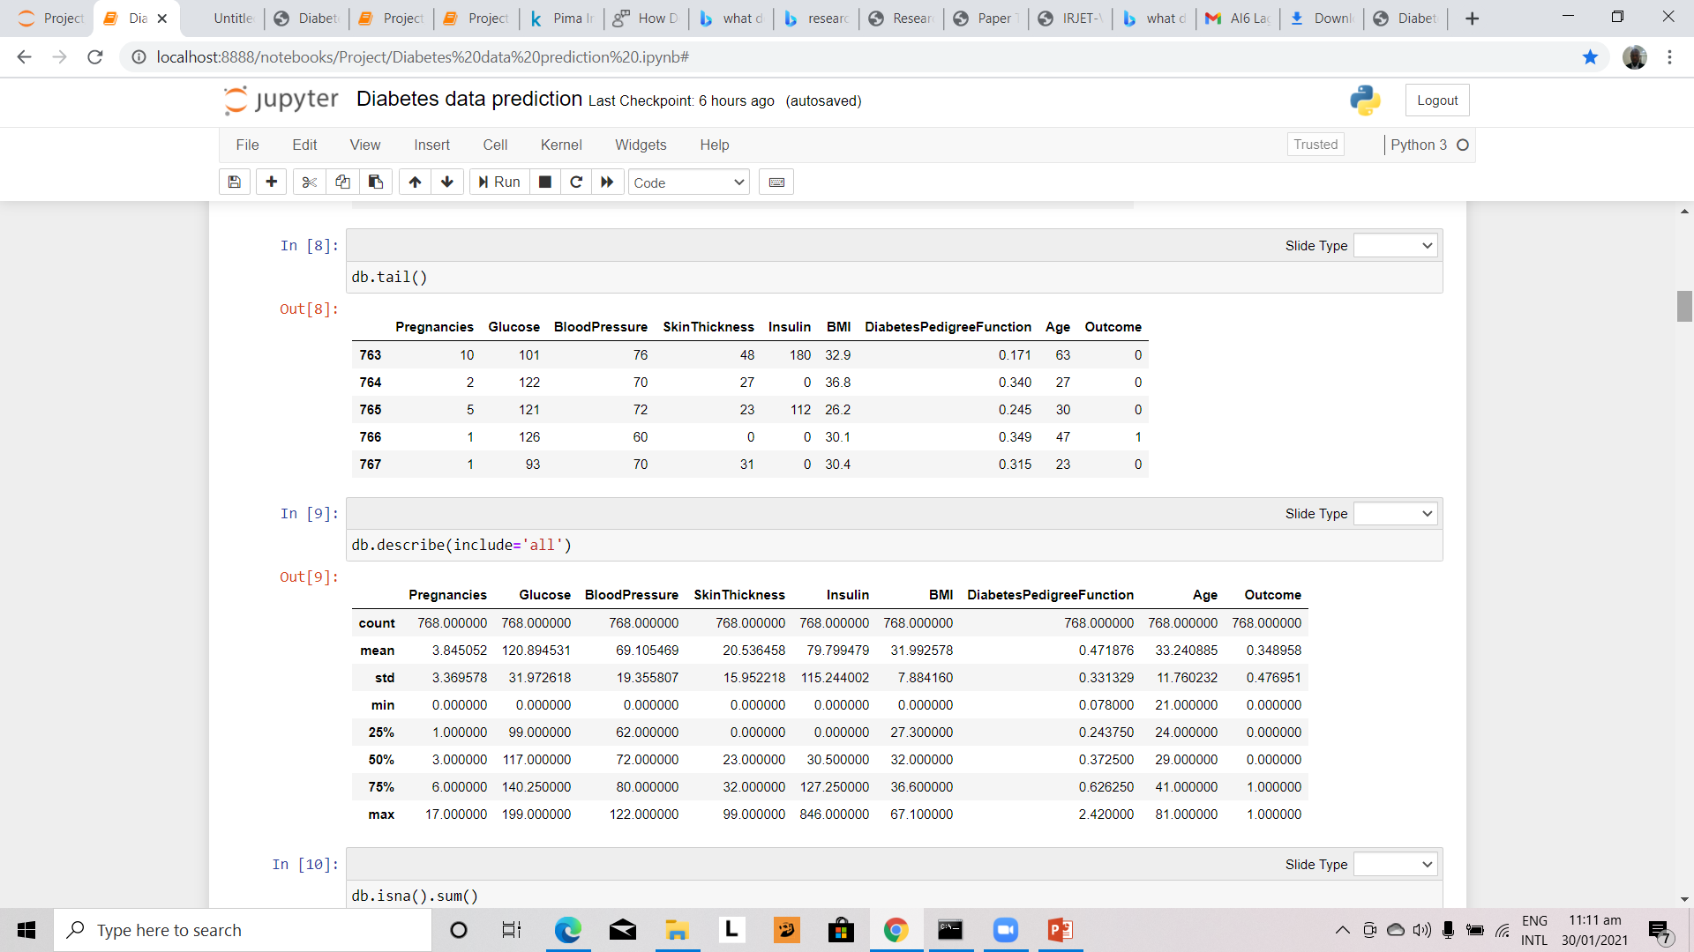

Slide 11
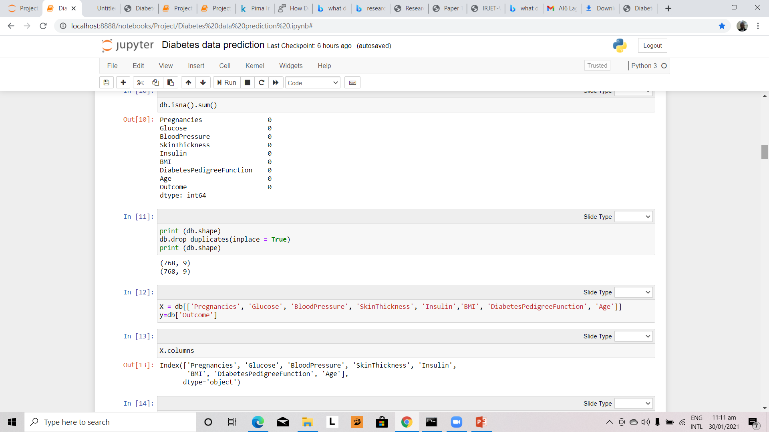

Slide 12
Data Visualization
Using Seaborn

Slide 13
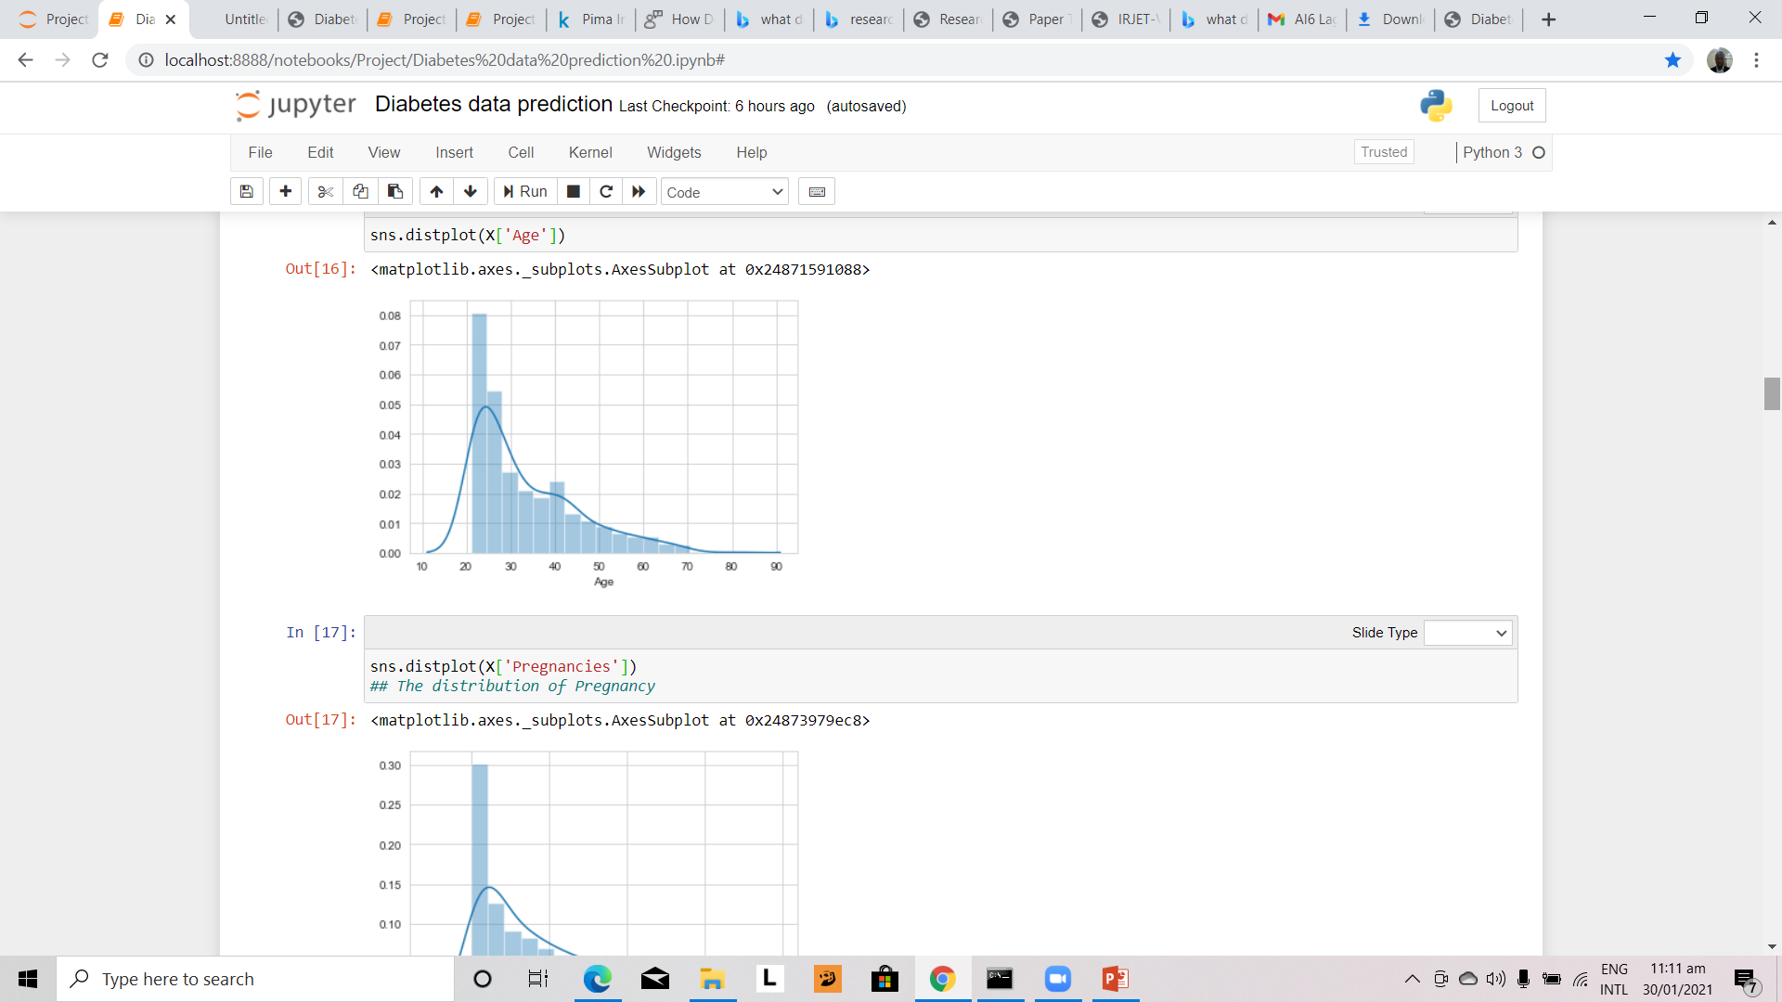

Slide 14
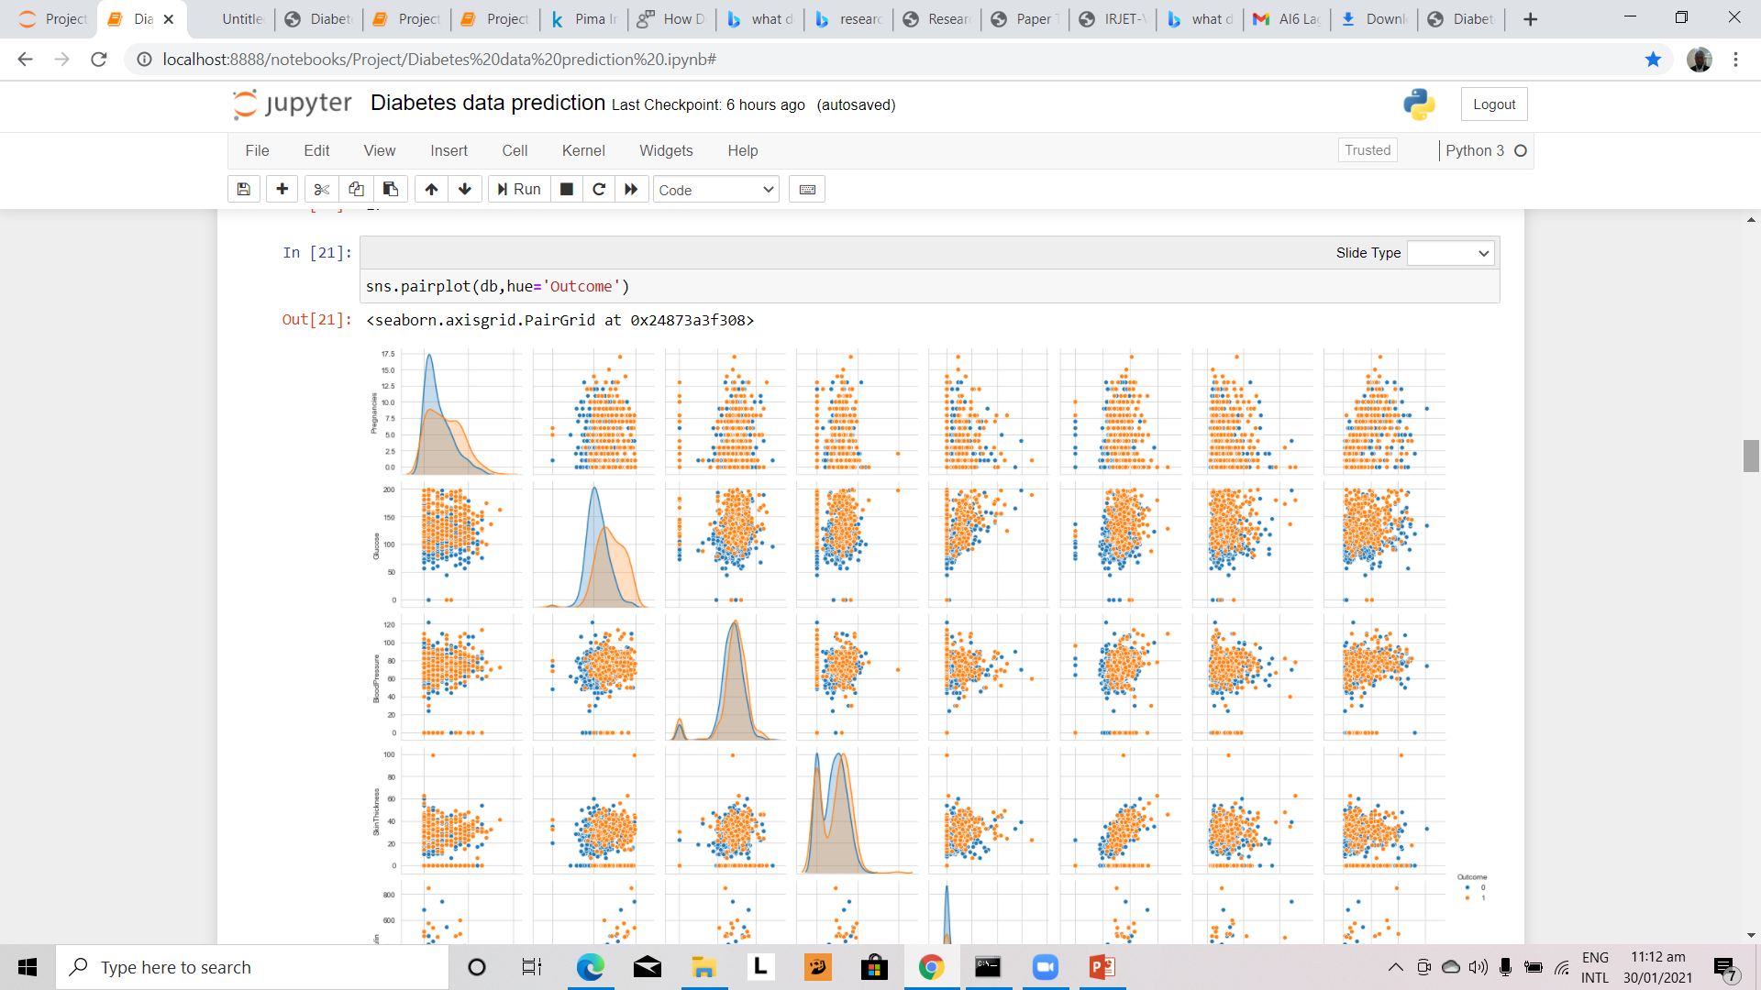

Slide 15
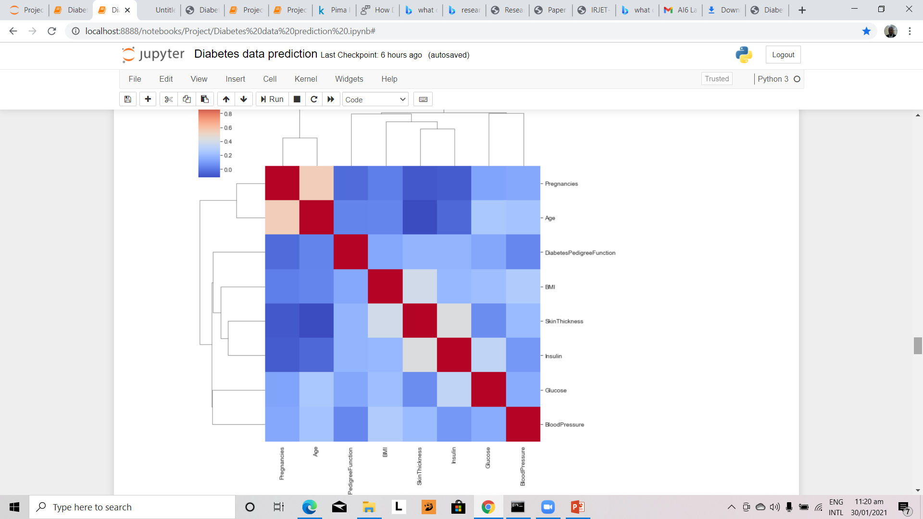

Slide 16
Checking For Outliers

Slide 17
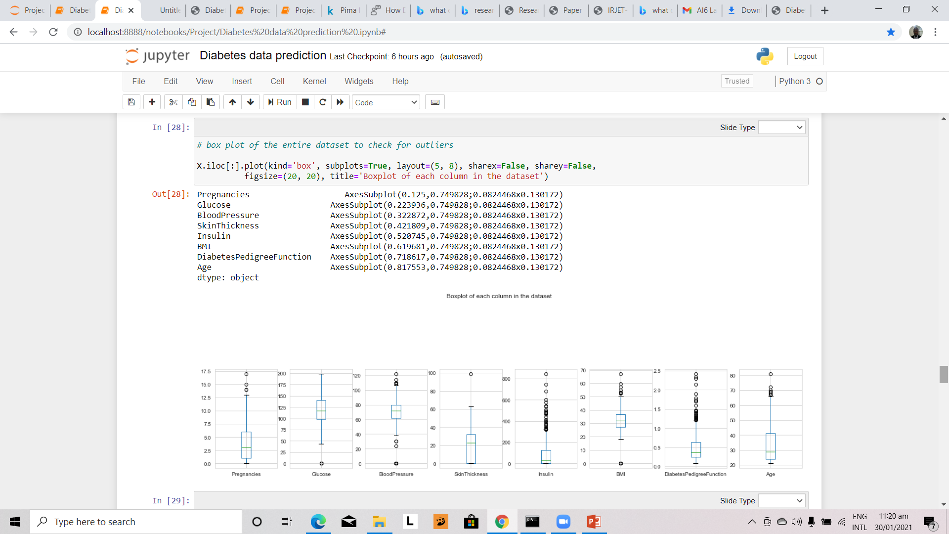

Slide 18
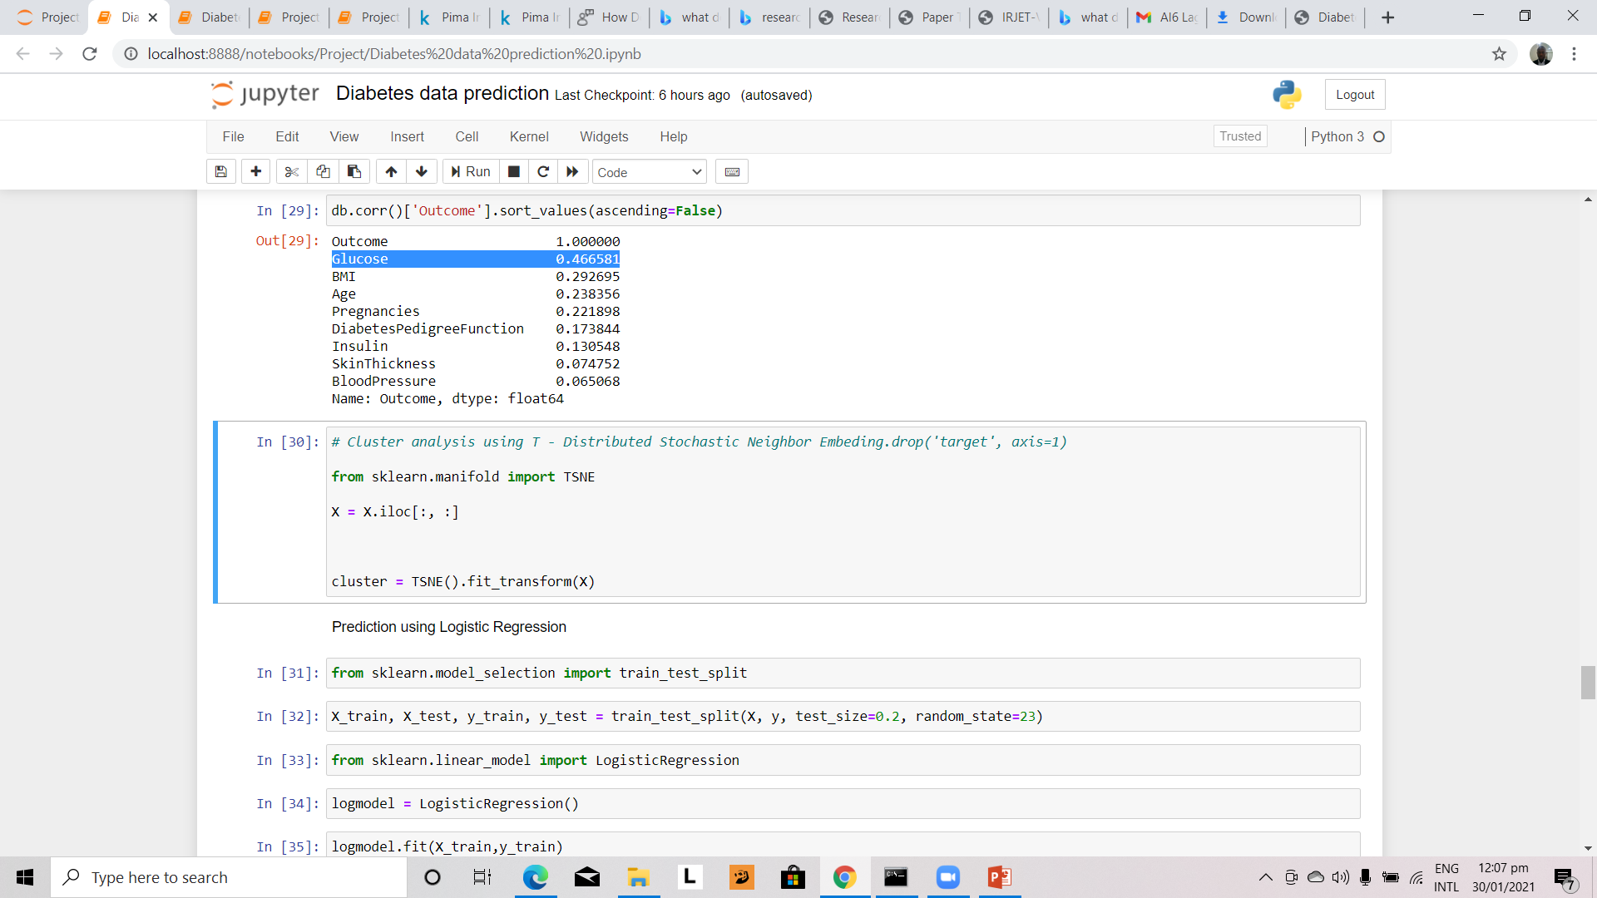

Slide 19
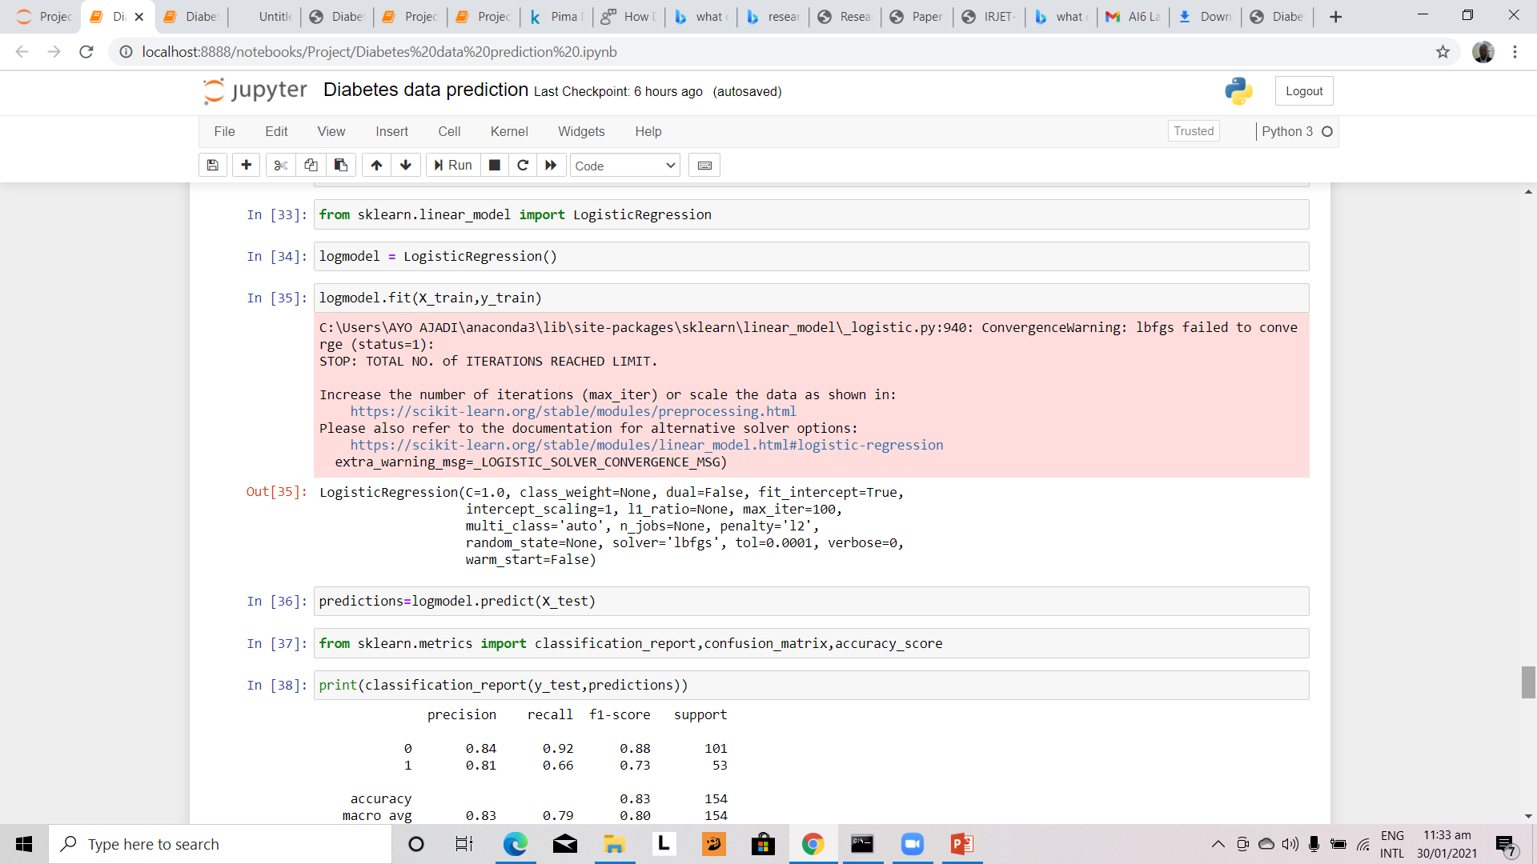

Slide 20
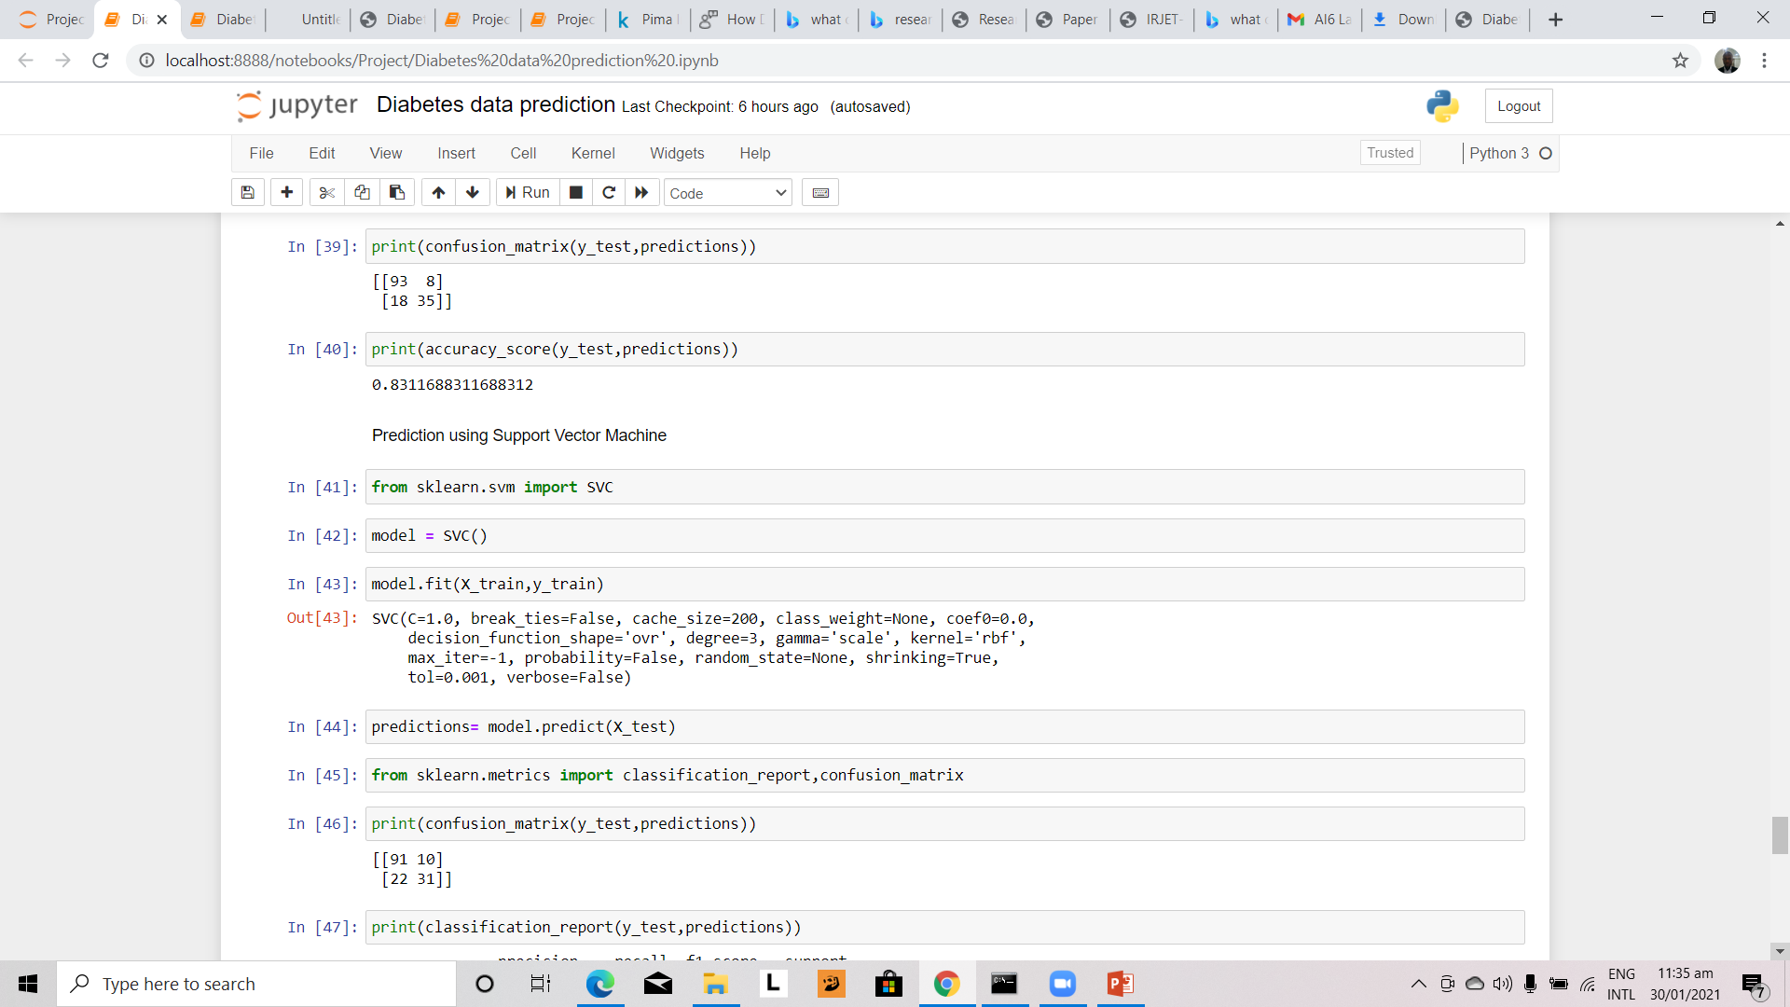

Slide 21
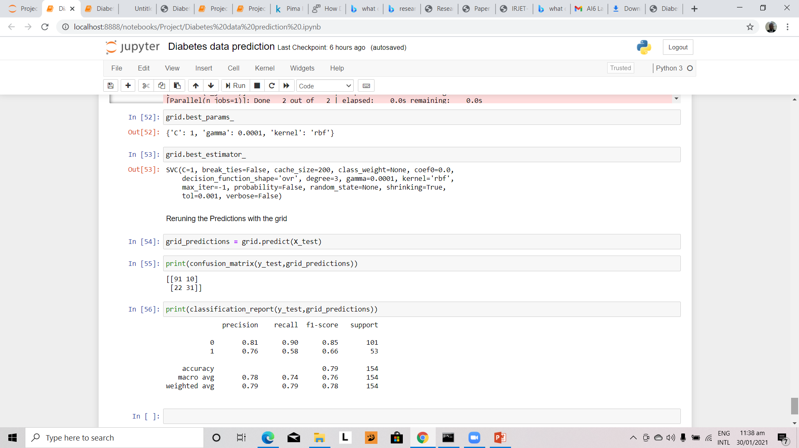

Slide 22
We first used logistic regression before using SVM
The results were almost the same but Logistic Regression was more accurate

Slide 23
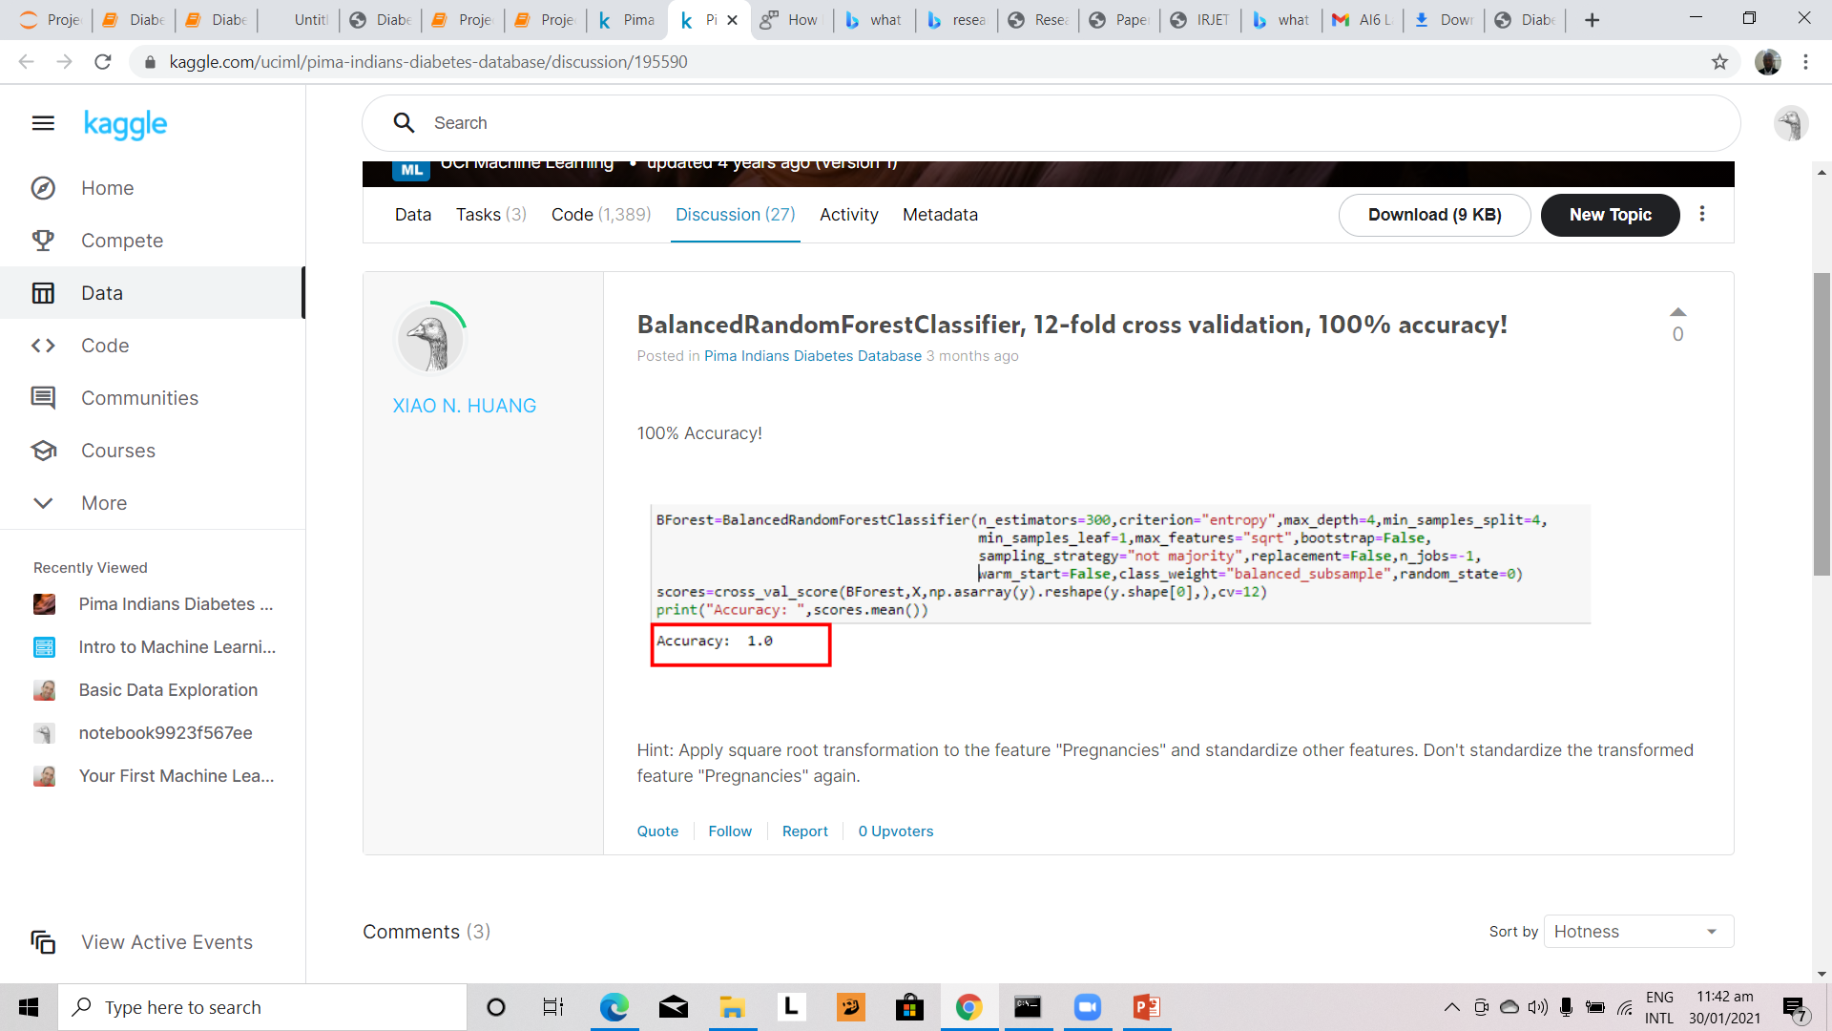

Slide 24
Other Works on Predicting Diabetes
Many statistical approaches such as Bayesian regularization (BR), Levenberg–Marquardt algorithm (LM) and scaled conjugate gradient (SCG) have been used for the evaluation and accuracy of predicting Diabetes.
Others include; support vector machine, artificial neural network, logistic regression, classification tree, and K-nearest neighbor.
The performance of the system is appraised in terms of accuracy, specificity, sensitivity, precision, negative predictive value, false positive rate, rate of misclassification, measure and receiver operating characteristic (roc) curve.

Slide 25
Research Paper
Diabetes Prediction: A Deep Learning Approach Safial Islam Ayon, Md. Milon Islam Department of Computer Science and Engineering, Khulna University of Engineering & Technology
Prediction of Diabetes Based on Artificial Intelligence Technique Shameem Hasan M.Sc. Engineering Student, Department of Electrical & Electronics Engineering, Islamic University of Technology (An organization of OIC), Gazipur-1704, Bangladesh

Slide 26
Further Research
This could be done by using neural network on this data
By getting more and varied data.
Recent research on the creation of covid vaccines showed that the pharmaceutical companies tried to determine the effectiveness of the vaccine on a large group of people, such as more than 50,000 people. And people across different segments – Blacks, Whites, Hispanics, Men, Women and others.
Therefore, there is need for more data in order to make the prediction more conclusive.

